Slide 1

Customer Churn Prediction In Telecom Industry
By : Soumit Kar
MBA in HRM and Marketing Management

Slide 2
Churn prediction detecting customers who are likely to cancel a subscription to a service. Churn is a problem for telecom companies because it is more expensive to acquire a new customer than to keep your existing one from leaving.
Procedure
Identify Problem Statements.
Data Collection
Exploratory Data Analysis
Feature Engineering
Feature Selection
Handling Imbalance Data
Model Selection
Create and Deploy App

Slide 3
Problem Statement
To predict Customer churn
Factor Affecting Customer Churn
what's the most profitable service types?
What's the amount lose in revenue?
Data Collection
Data collected from Kaggle.
Customers who left within the last month – the column is called Churn
Services that each customer has signed up for – phone, multiple lines, internet, online security, online backup, device protection, tech support, and streaming TV and movies
Customer account information – how long they’ve been a customer, contract, payment method, paperless billing, monthly charges, and total charges
Demographic info about customers – gender, age range, and if they have partners and dependents

Slide 4
Data Audit
Drop 11 missing values in ‘Total Charges’ column as per no use
Libraries
pandas
numpy
matplotlib
seaborn
scipy
statsmodels
sklearn
lifelines
Sweet viz
xgboost
lightgbm
catboost
pickle
Imblearn
Collections
Eli5
Pdpbox
sha
joblib

Slide 5
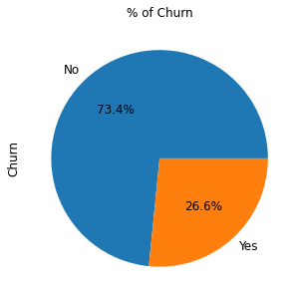
EDA
From KDE Plot
Recent clients are more likely to churn.
Clients with higher Monthly Charges are also more likely to churn.
Tenure and Monthly Charges are probably important features.
From boxplot
75% of churners pay between 60 and 100 dollars a month
One important mark we can see in this plots that 50% of Churners leave the company before the first year goes by.

Slide 6
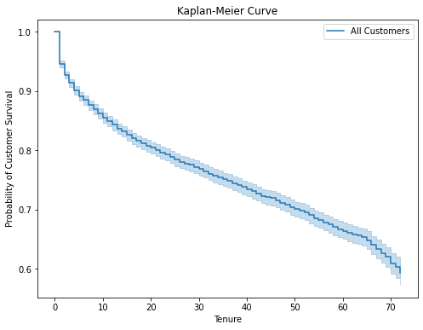
Survival Analysis (Kaplan Meier Curve)
sudden drop in the starting which says that after one tenure only customers starts churning rapidly and after that churning rate decreases.

Slide 7
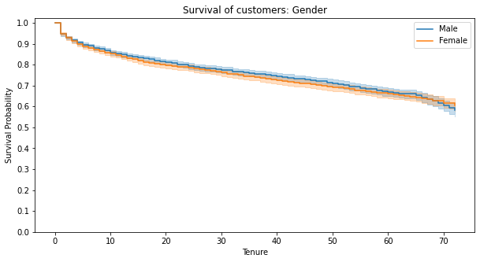
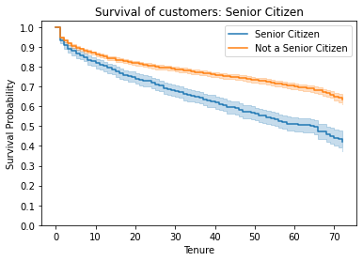
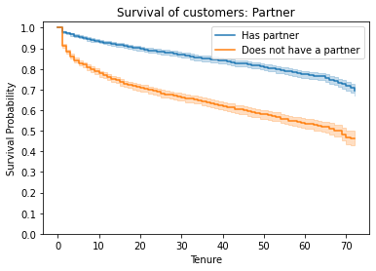
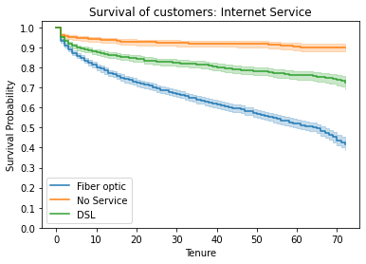

Slide 8
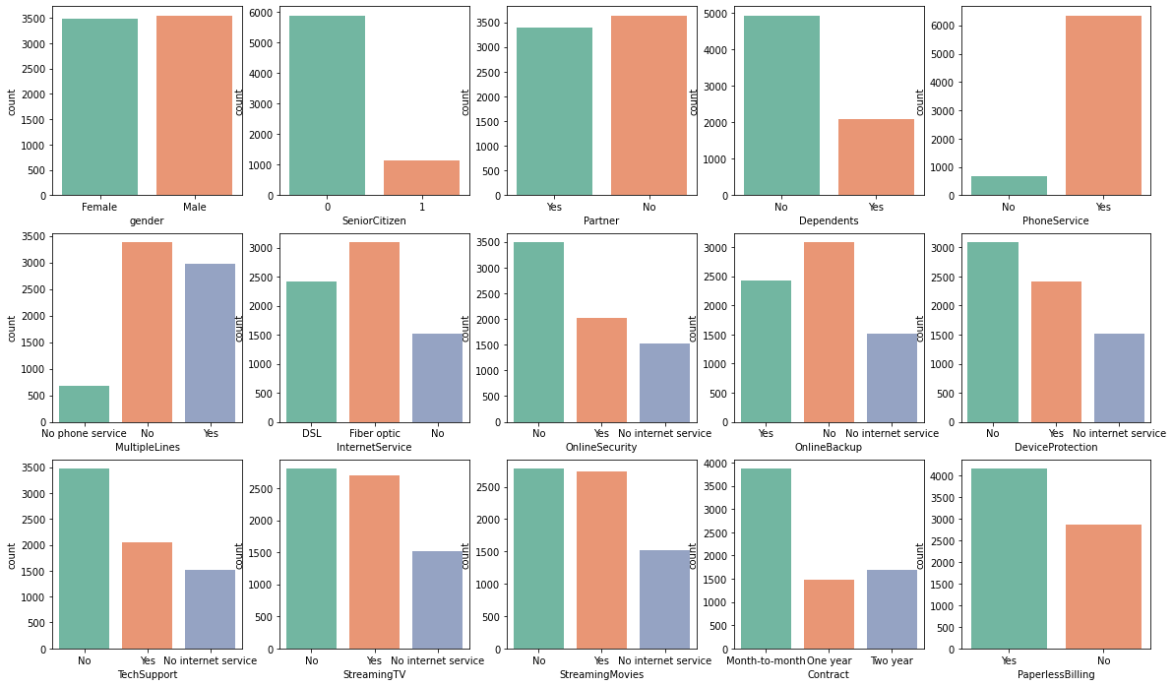
Count plot

Slide 9
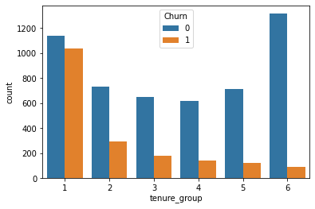
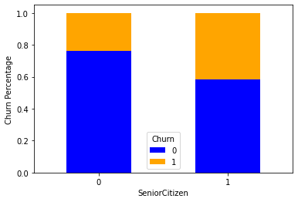
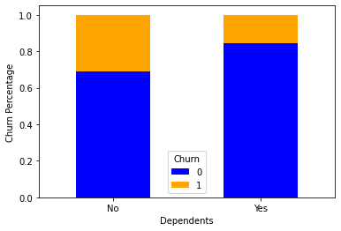
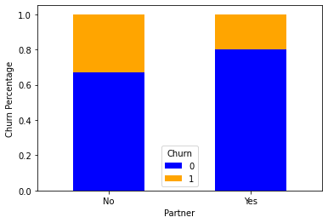

Slide 10
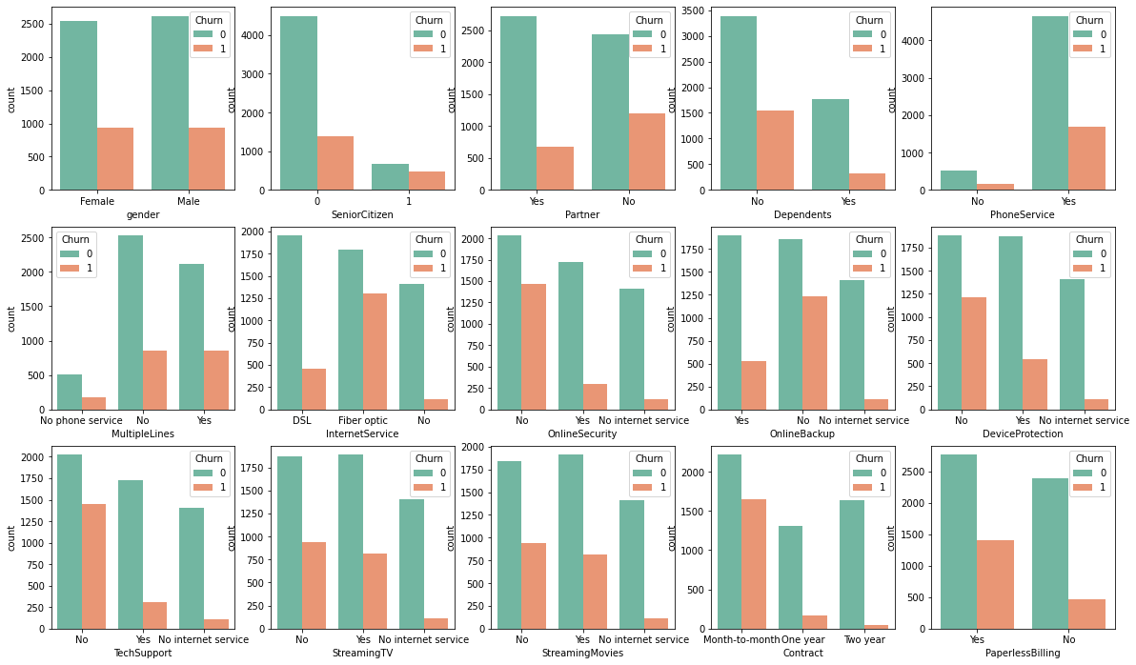

Slide 11
Gender - The churn percent is almost equal in case of Male and Females
The percent of churn is higher in case of senior citizens
Customers with Partners and Dependents have lower churn rate as compared to those who don't have partners & Dependents.
Churn rate is much higher in case of Fiber Optic Internet Services.
Customers who do not have services like No OnlineSecurity , Online Backup and TechSupport have left the platform in the past month.
A larger percent of Customers with monthly subscription have left when compared to Customers with one or two year contract.
Churn percent is higher in case of customers having paperless billing option.
Customers who have Electronic Check Payment Method tend to leave the platform more when compared to other options.

Slide 12
Revenue analysis
31% of total revenue was "lost" by people who left.
Optical fiber is responsible for 53% (168,99k) of the monthly revenue, DSL 37% (118,14k)
87% of all monthly revenue lost are caused by customers with Month-to-Month Contracts

Slide 13
Cheak Outliers
Checked outliers by IQR method no outliers detected.
Encoding
Convert tenure group to 5 groups
Categorical columns to dummy variables, as there is yes / no values

Slide 14
Feature selection
Drop customer ID column
For feature selection used chi2 test
Gender, Multiplelines, Phone Servies have greater p-value, so null- hypothesis rejected also in survival curve there is no importance.
Drop columns with 0.9 of correlation
1.DeviceProtection_No internet service
2.OnlineBackup_No internet service
3.OnlineSecurity_No internet service
4,StreamingMovies_No internet service
5.StreamingTV_No internet service
6.TechSupport_No internet service

Slide 15
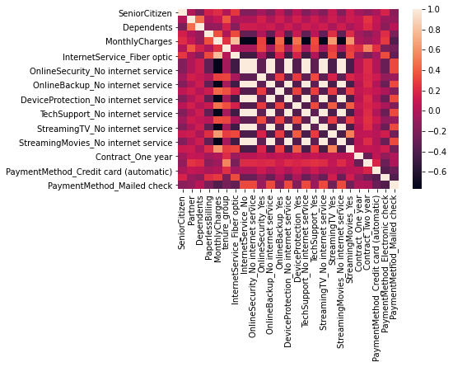
Heat map

Slide 16
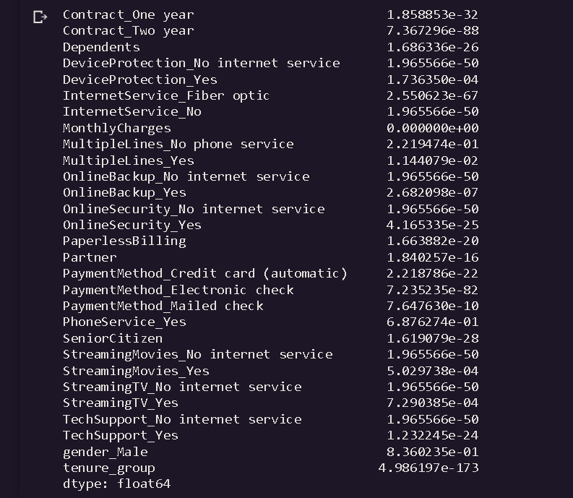
Feature Importance for chi2 test

Slide 17
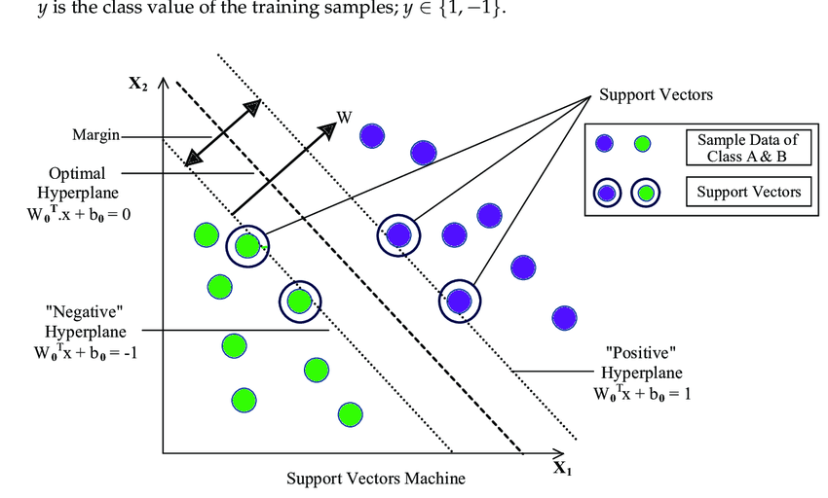
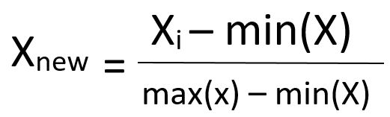
Transformation
K-Nearest Neighbour and Support Vector Machine need Scaling data
These distanced based algorithms finds the closer distance between data points and find similarities
Minmax Scaler
Transfer the data range(1,0)
[SVM]

Slide 18
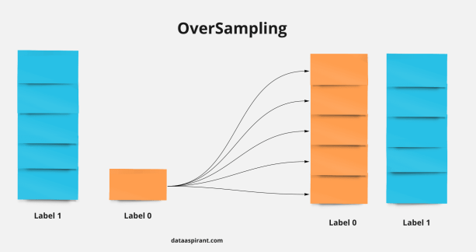
Imbalance data Handling
Oversampling
Smote Tomek
Tomek links to the over-sampling instead of removing only the majority class examples that form Tomek links, examples from both classes are removed
The num of classes before fit Counter({Not Churn: 4125, Churn: 1500})
the num of classes after fit Counter({Not Churn: 3949, Churn: 2711})

Slide 19
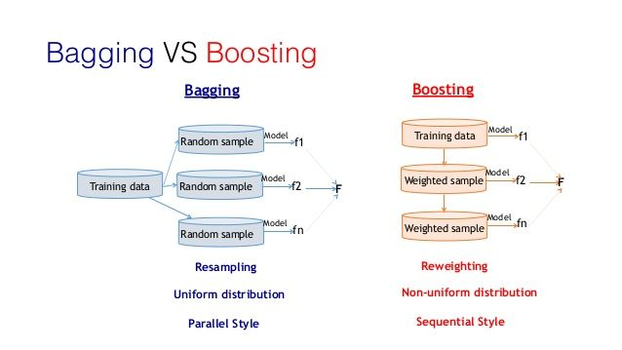
Ensemble Learning

Slide 20
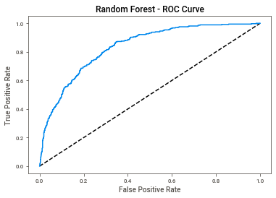
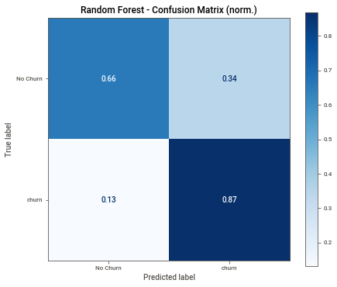
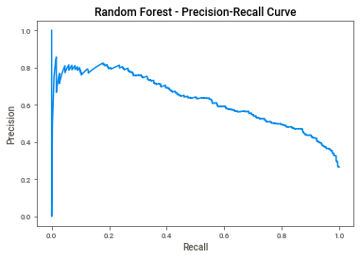
Random Forest Classifier
Select Random Forest classifier for model Building
AUC Score (ROC): 0.8343163055908016
F1 score: 0.5548387096774193
AUC Score (PR): 0.627076181352386

Slide 21
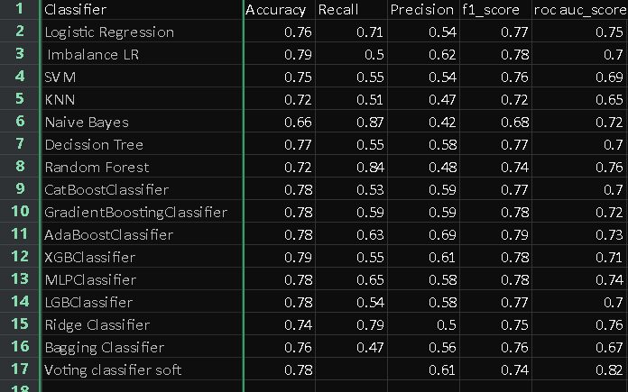
ALL Classifiers

Slide 22
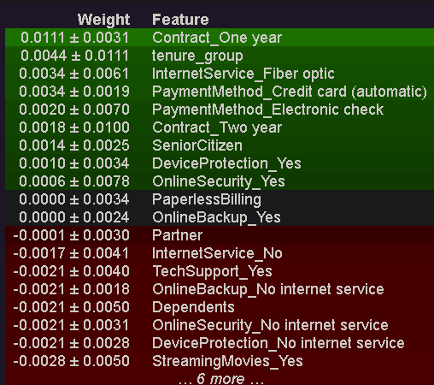
Random Forest Classifier feature wt

Slide 23
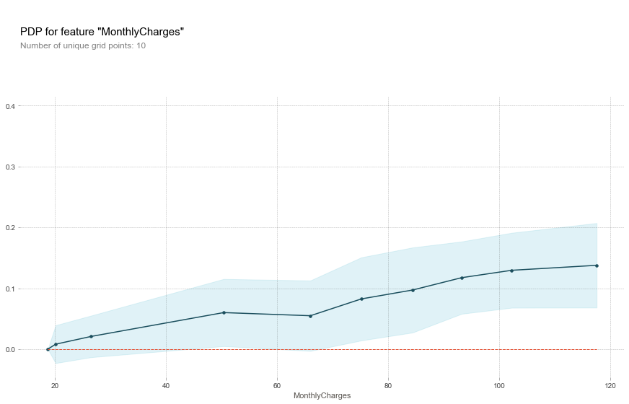
partial dependence plot
PDPbox is a partial dependence plot toolbox written in Python. The goal is to visualize the impact of certain features towards model prediction for any supervised learning algorithm. (now support all scikit-learn algorithms)

Slide 24
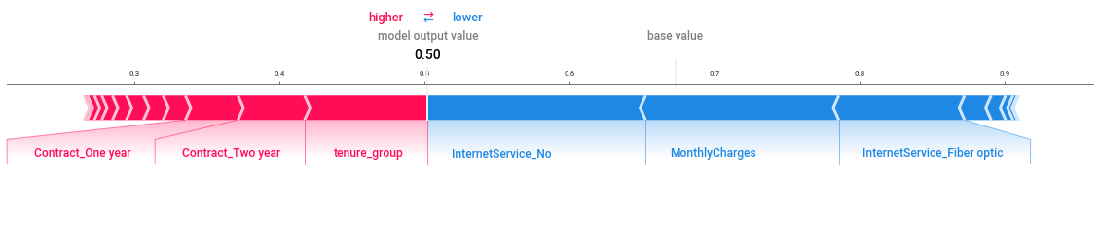
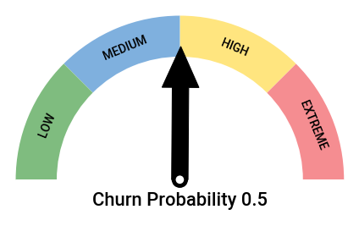
SHAP (SHapley Additive exPlanations) is a game theoretic approach to explain the output of any machine learning model.
Gauge chart use for indicating the performance as per churning probabilities.

Slide 25
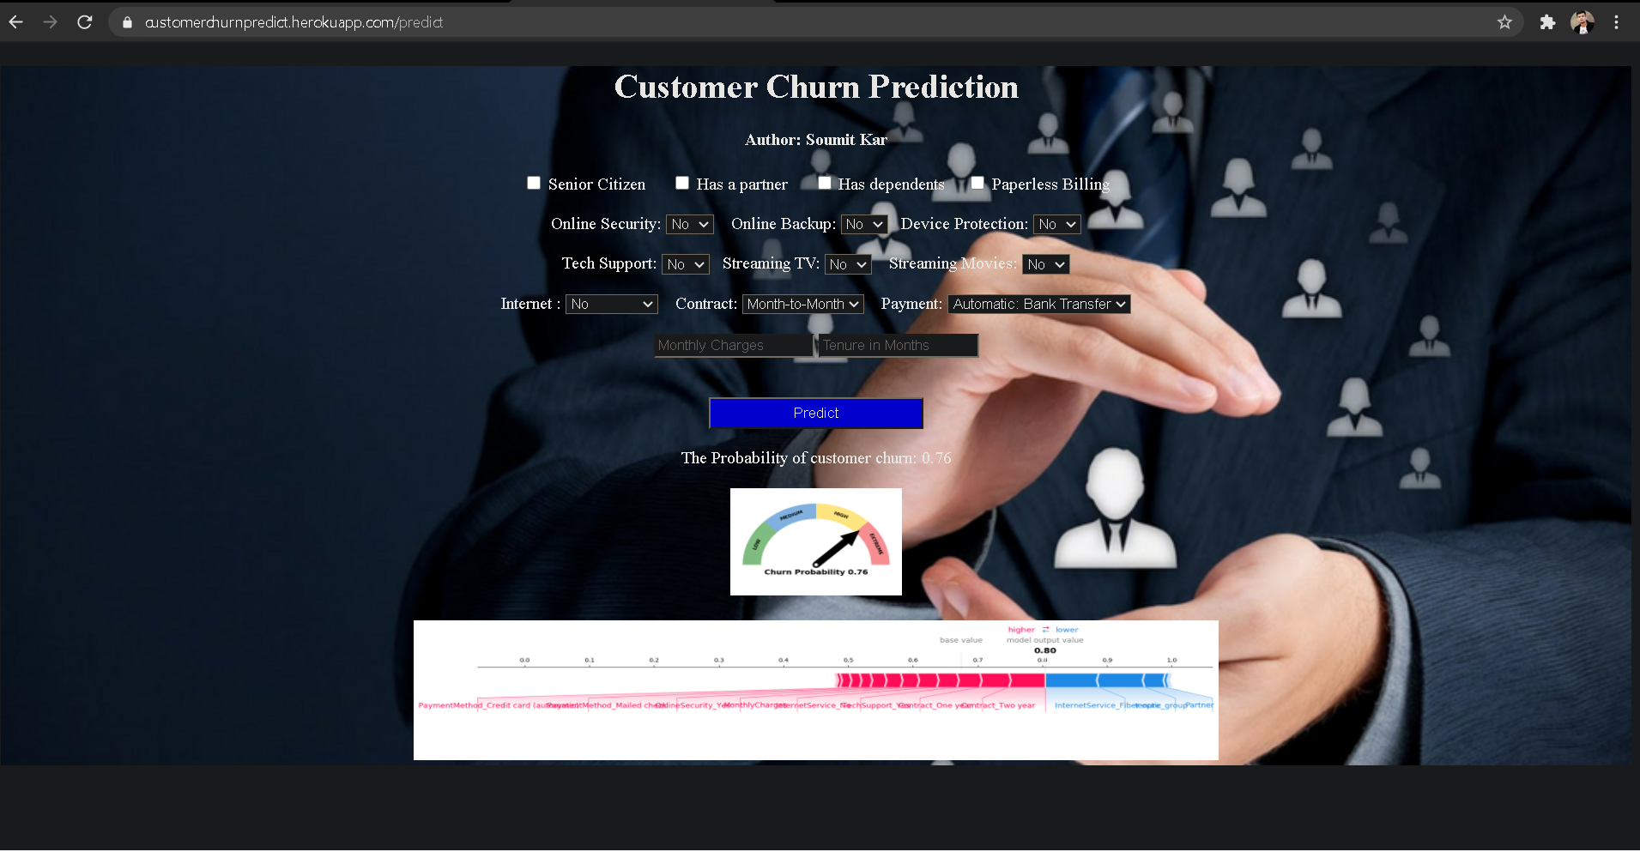
Github - Link
Go to web App - Link
Medium - Link

Slide 26
Reduce Telecom Customer Churn & Conclusion
Use the App to predict churn probabilities
Engage with your customers
Define your most valuable customers
Give better service
Pay attention to complaints
Make your best people deal with customers at risk
Flaunt your competitive advantages
Offer long term contracts

